Slide 1


MediMind: A Comprehensive Health Prediction and Record Keeping Platform
By
Aditya sharma(1ms20cs008)
Danish Mahajan(1ms20cs037) Dhruv khandelwal(1ms20cs044) Arpit gajya(1ms20cs149)
Under the Guidance
of
DARSHANA A .NAIK

Slide 2
PROBLEM STATEMENT
MediMind is a platform designed to keep comprehensive health records of individuals and provide personalized health predictions based on their data. It aims to revolutionize the healthcare industry by utilizing advanced technologies such as AI and machine learning to analyze data and predict potential health issues before they occur. MediMind aims to improve patient outcomes and reduce healthcare costs by enabling early detection and intervention of potential health problems.

Slide 3
INTRODUCTION
MediMind is a comprehensive record-keeping and disease prediction platform that aims to revolutionize the healthcare industry by leveraging advanced technologies to improve patient outcomes. The platform provides a range of features that enable patients and healthcare providers to manage patient data, track disease progression, and predict the likelihood of future health events.

Slide 4


AGENDA
Early diagnosis: MediMind can be used to identify patients who are at risk of developing a particular disease, even before the onset of clinical symptoms. Early diagnosis can enable early treatment, which can improve patient outcomes and reduce healthcare costs.
Accurate record keeping: The primary objective of MediMind is to maintain accurate and up-to-date records of patient health information, including medical history .This information is used by healthcare providers to make informed decisions about patient care.
•

Slide 5
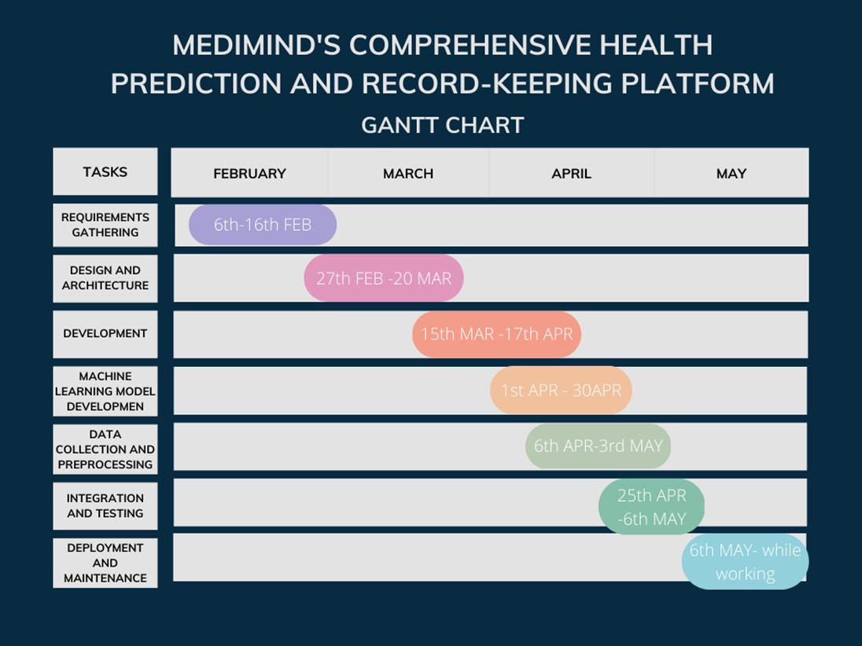
SCHEDULE PLANNING
Fig 1
Gantt Chart of our Project Planning

Slide 6
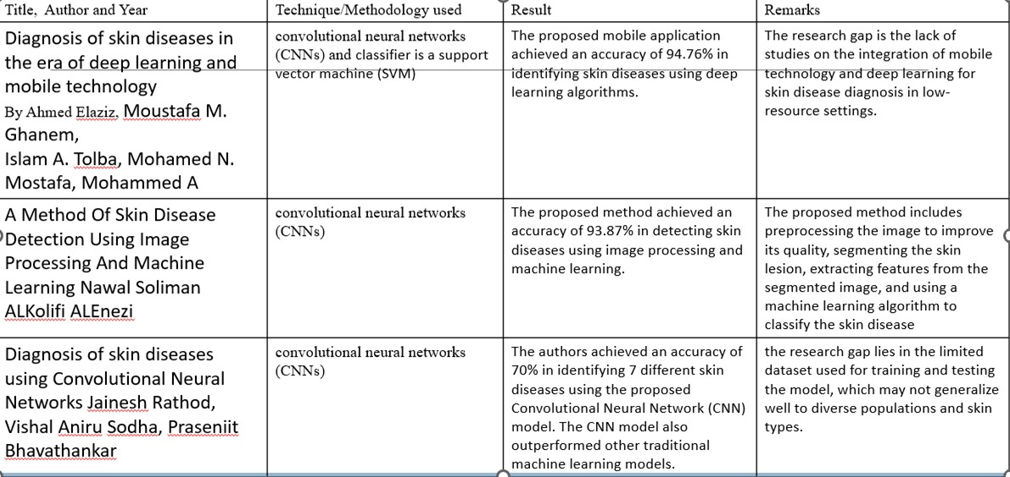
LITERATURE SURVEY

Slide 7
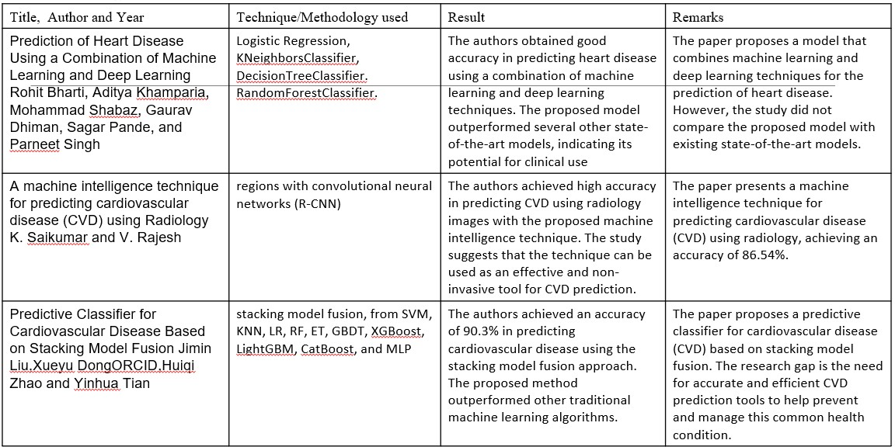

Slide 8




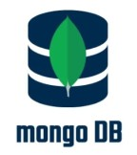

TECHNOLOGIES USED AT EACH STAGE
PHASE I
Designing the UI/UX using Figma, and using React Framework in the Frontend. Bootstrap is used to design the components of the Frontend. We are using react to create components
PHASE II
In this phase, we are using the technologies such as node.js, express.js for implementing the backend and to store the information of Volunteers using mongoDB. Using JWT we implement the authentication of the user.

Slide 9
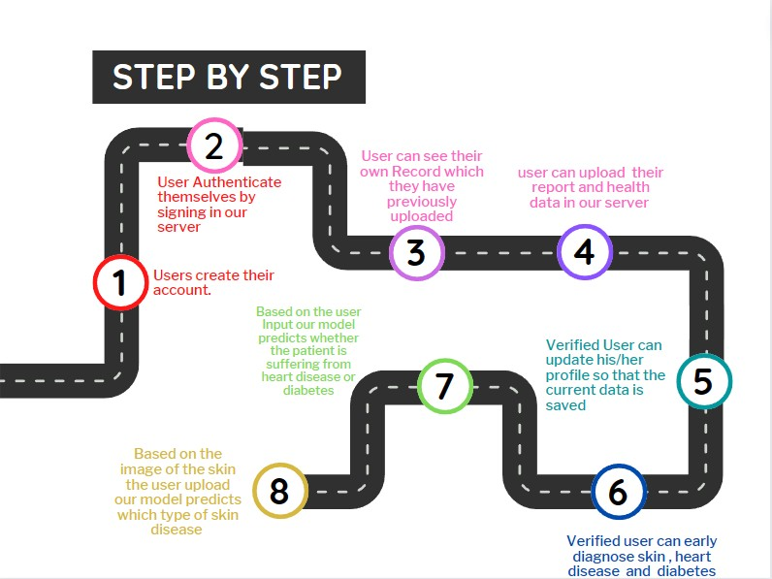
OVERALL VIEW OF THE PROJECT IN TERMS OF
IMPLEMENTATION
Fig 2 Step by step guide for the user

Slide 10
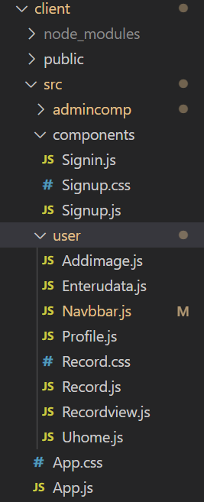
SYSTEM ARCHITECTURE
Client-server architecture, the software system is divided into two main components: the client and the server. The client is typically a user interface that allows users to interact with the system, while the server provides the core functionality and stores the data.
Fig 3 It shows the client File
Structure

Slide 11
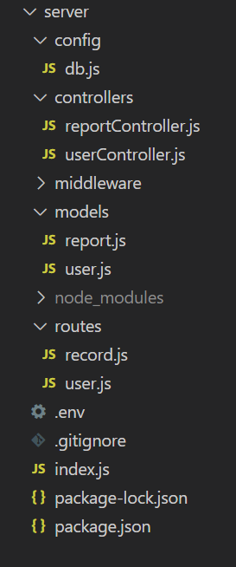
SERVER
This is a Server Architecture which includes different module to provide scalability to the project The server is divided into models which contains the schema of the user and the record How they are stored in the database
The route module shows what are the routes that our project support such as http://localhose:8000/api/user/signin for signIn of the user
Similarly the config file contains the code for connectivity with the database
Fig 4 It shows the Server Architecture

Slide 12
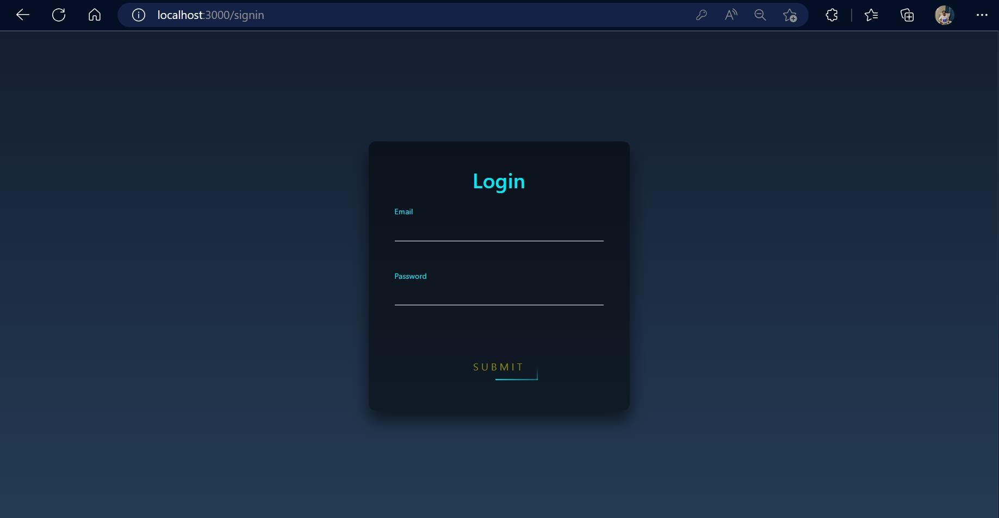
FIG 5.This is a signup / login page for the user to signup and create account

Slide 13
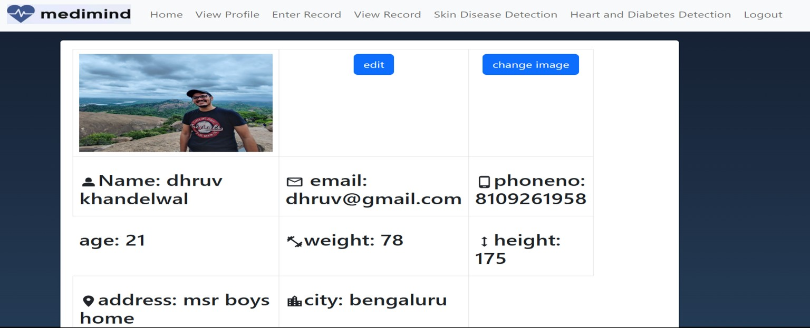
Result Snapshot
Edit Profile/View Profile-
This is a Profile Page of a user User can update his profile and manage his/her data which get stored in database in real time
User can also upload his image which gets upload in a cloud platform called Cloudinary
Fig 6. User Interface for the patient health record

Slide 14
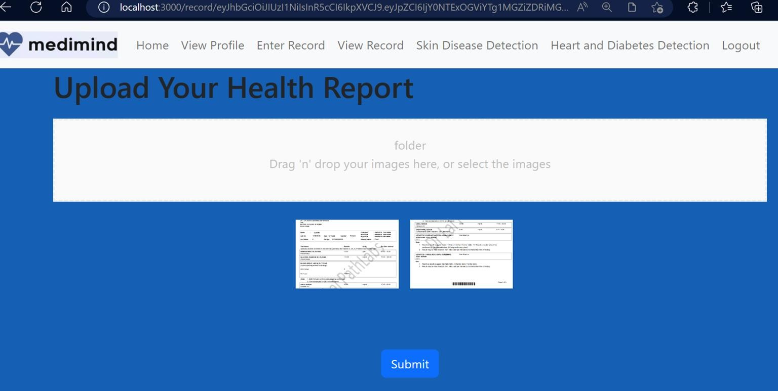
Result Snapshot
This is a page from where the user can upload his health record
The health record is uploaded in a cloud platform named cloudinary and saved in our database
Fig 7. User entering the health report

Slide 15
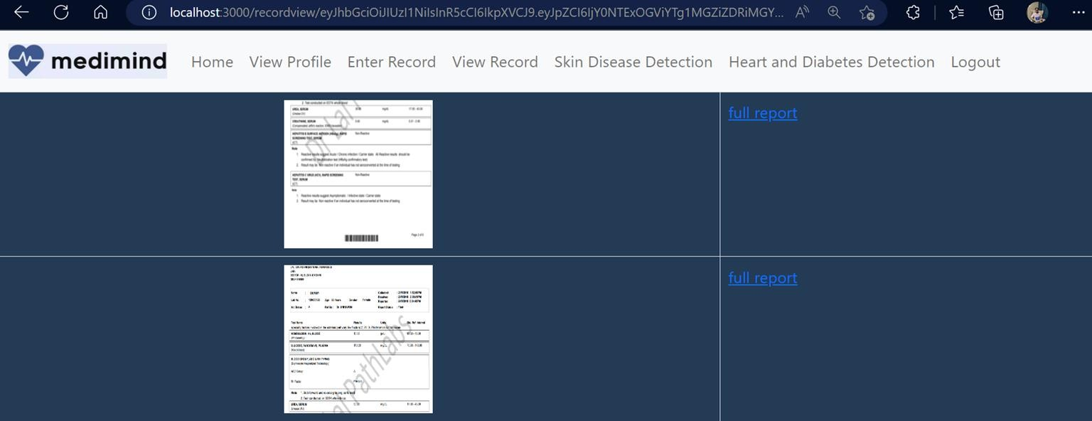
Result Snapshot
This is a page where the user can view all the record that he has uploaded
The data is fetch from the database
Fig 8. User viewing the health report

Slide 16
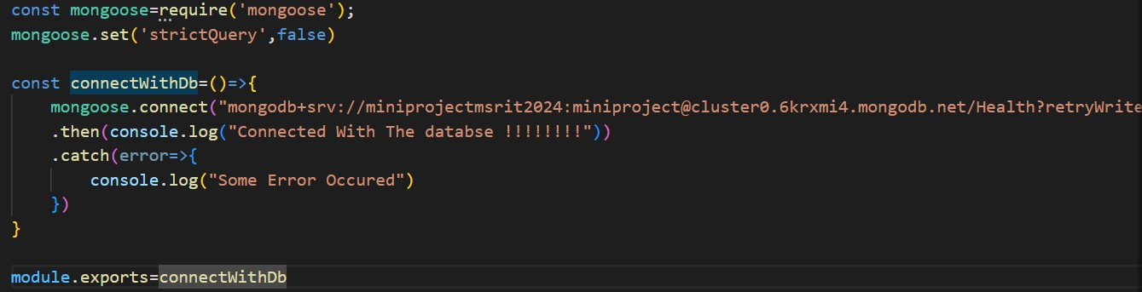
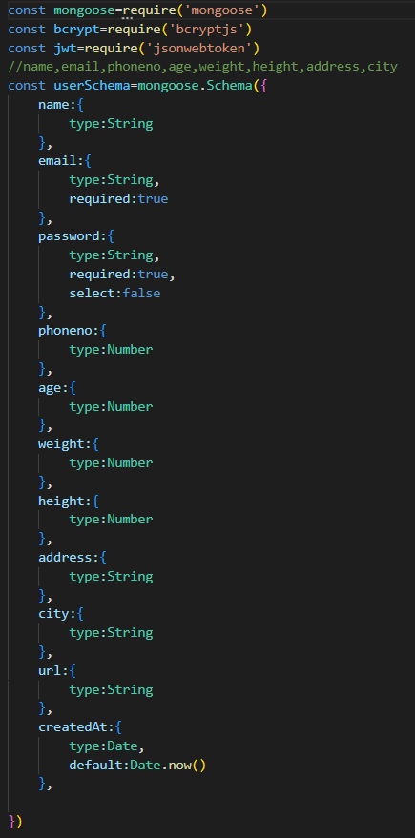
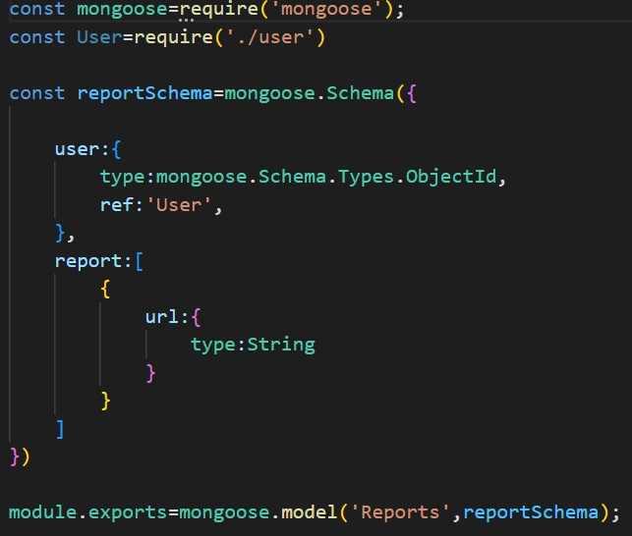
Fig 9 Code For Database Connectivity
Fig 10 & 11 Shows the User and Record Model

Slide 17
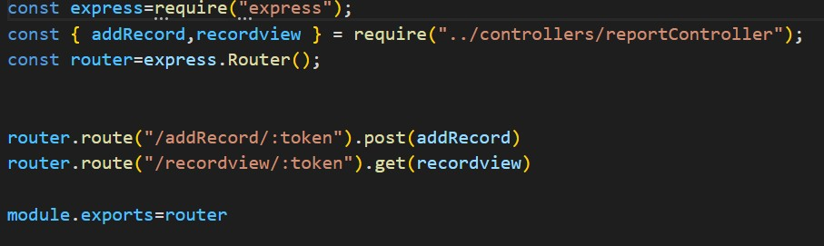
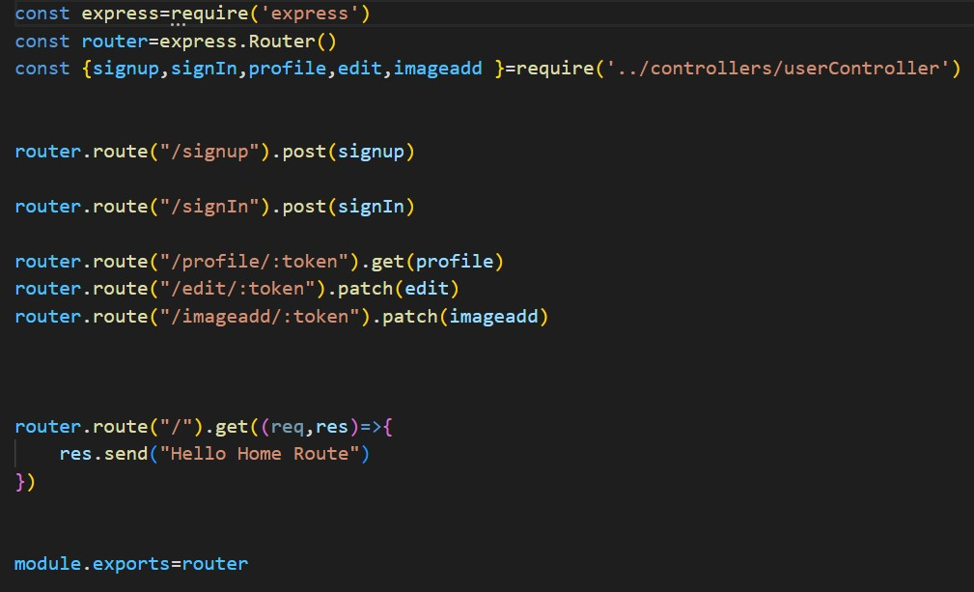
Fig 12 & 13 Shows The Route for User and record Saving

Slide 18



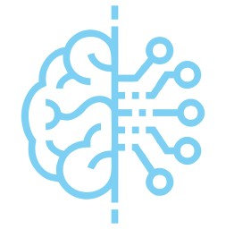
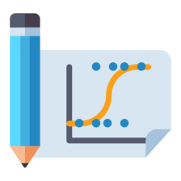
TECHNOLOGIES USED AT EACH STAGE
PHASE III
In this phase, we will use Tensorflow,keras and csv file with other required libraries to train the model.
PHASE IV
In this phase their is implementation of Logistic Regression and Cnn model using the phase 3 setup for Predictive Analysis of Skin Disease ,Heart and Diabetics

Slide 19
ALGORITHMIC DESCRIPTION
A CNN (Convolutional Neural Network) is a type of artificial intelligence model designed to process and
analyze visual data, such as images and videos.
CNN uses a series of mathematical operations called convolutions to extract important features from an input image. These convolutions are essentially filters that slide across the image, looking for patterns in the pixel values.
The output of these convolutions is then passed through a series of layers, which help to identify increasingly complex patterns and structures in the image. This process is called feature extraction.
Finally, the output of the last layer is fed into a classification layer, which assigns a label to the input image based on the features that were extracted. This allows the CNN to recognize and classify objects within an image.

Slide 20
ALGORITHMIC DESCRIPTION
Logistic regression is a statistical method used to analyze the relationship between a binary (yes/no)
dependent variable and one or more independent variables.This is a supervised learning technique.
The main goal of logistic regression is to predict the probability of a certain event happening based on input variables.
The logistic regression model works by fitting a curve to the data points that best describes the relationship between the input variables and the outcome. The curve is called the logistic function or sigmoid function, and it outputs a value between 0 and 1, which represents the predicted probability of the event occurring.
The model then calculates a threshold value (usually 0.5) and classifies each observation as either positive (event occurs) or negative (event does not occur) based on whether the predicted probability is above or below the threshold.

Slide 21
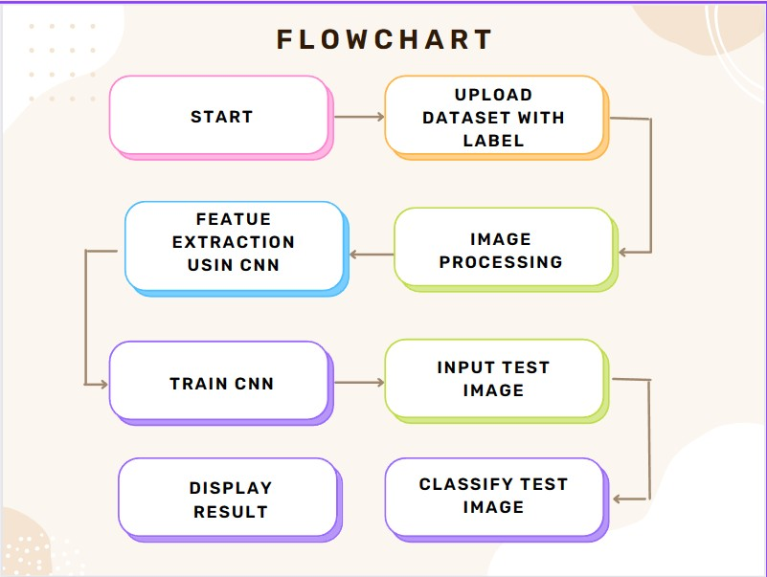
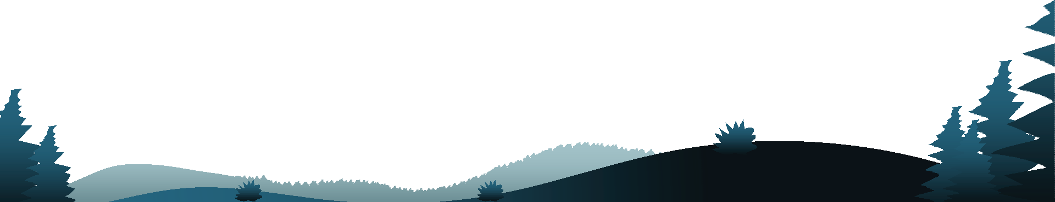
Fig 14 Flowchart for Skin Diagnosis

Slide 22
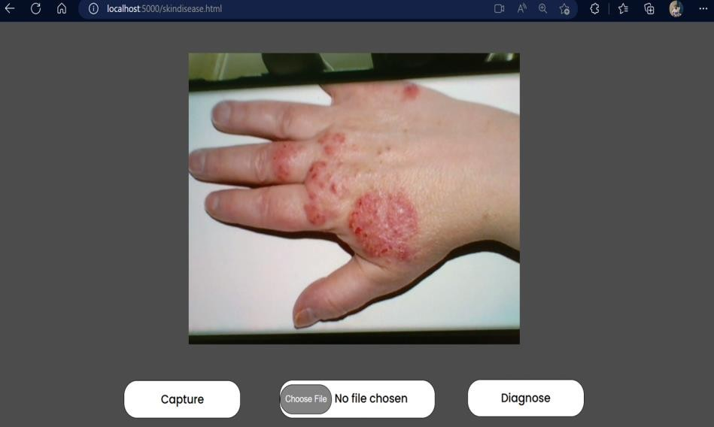
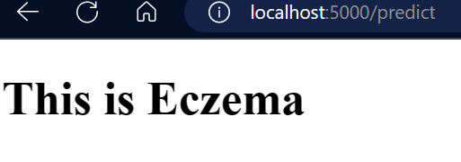
Result Snapshot
Fig 17. The name of the disease as
output
Fig 15. User giving the image of diseased part

Slide 23
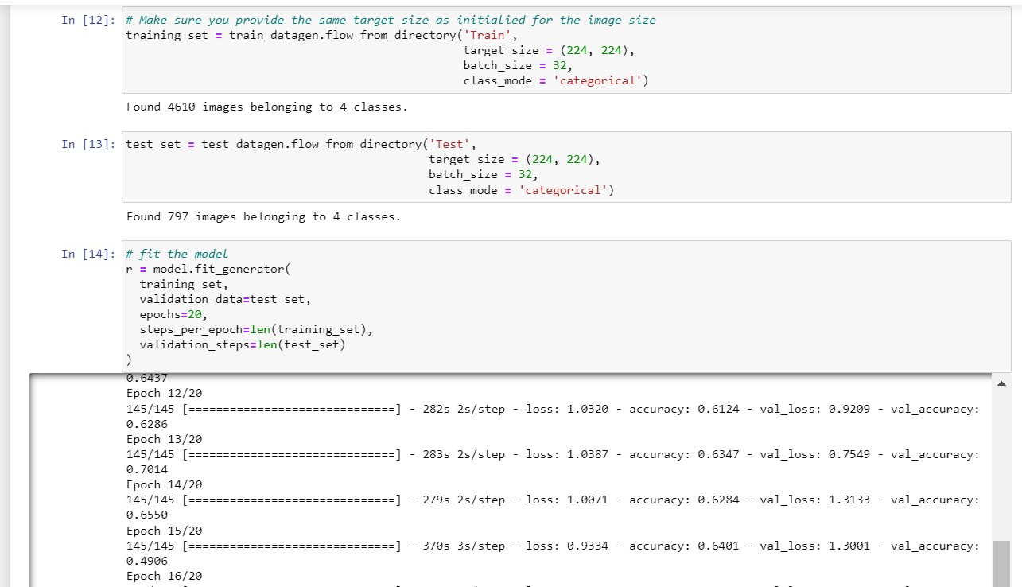
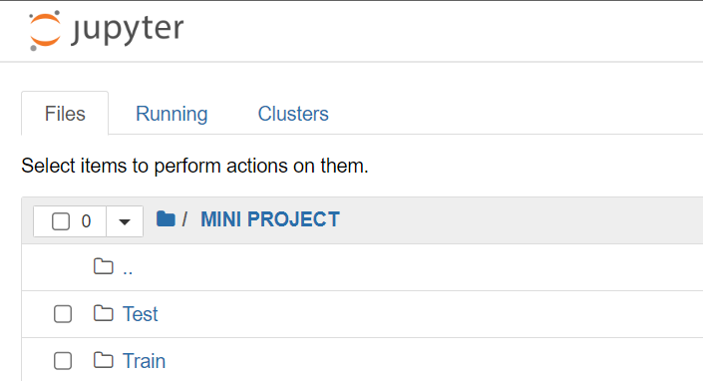
Fig 16. Test and Training Dataset
Fig 17. Training of Model

Slide 24
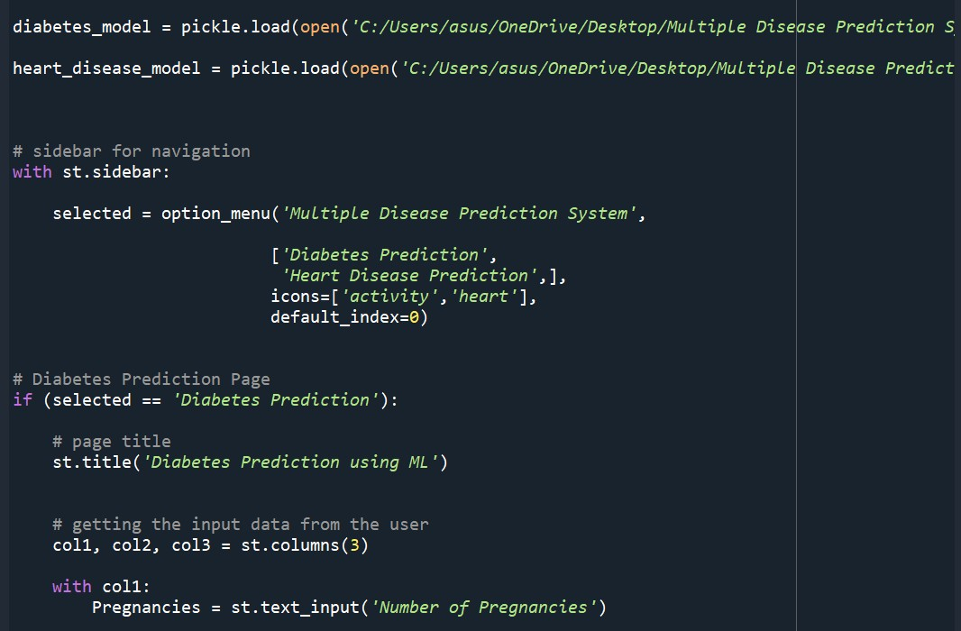
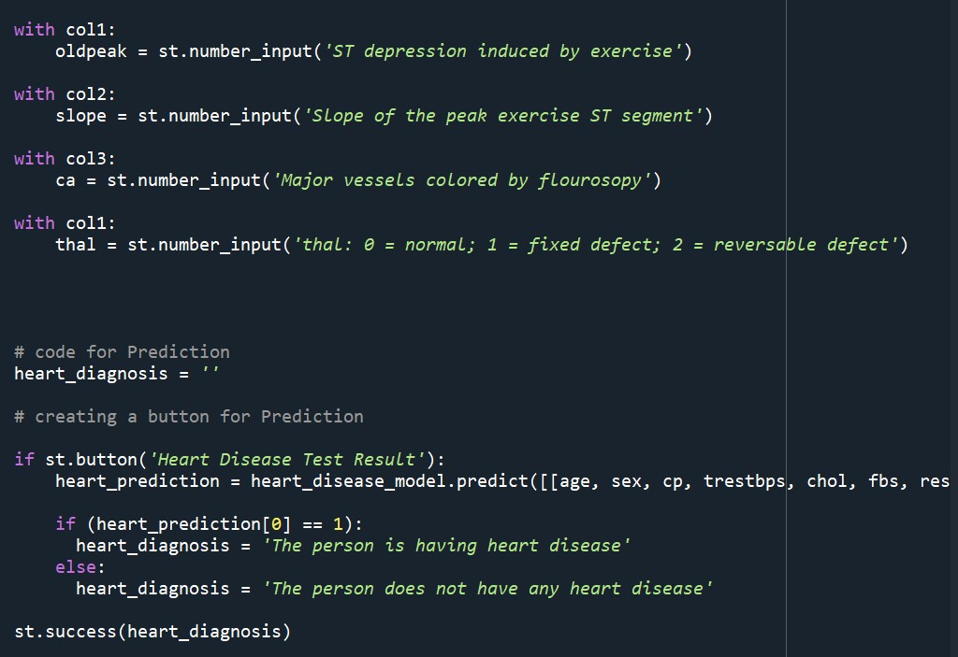
Fig 18 & 19 Backend Code snippet for Heart and Diabetes Diagnoses

Slide 25
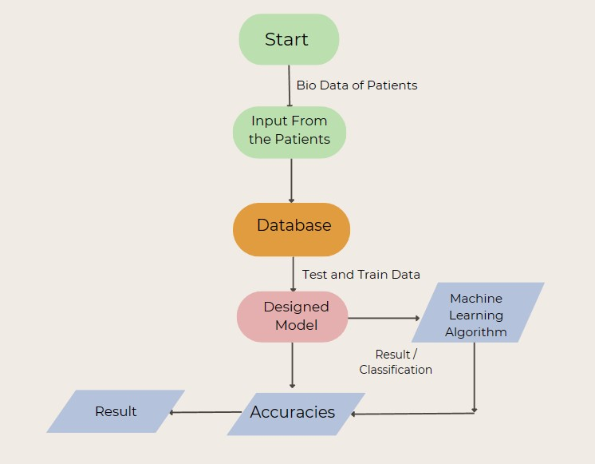

Fig 20 Process Flow for Diabetes and Heart

Slide 26
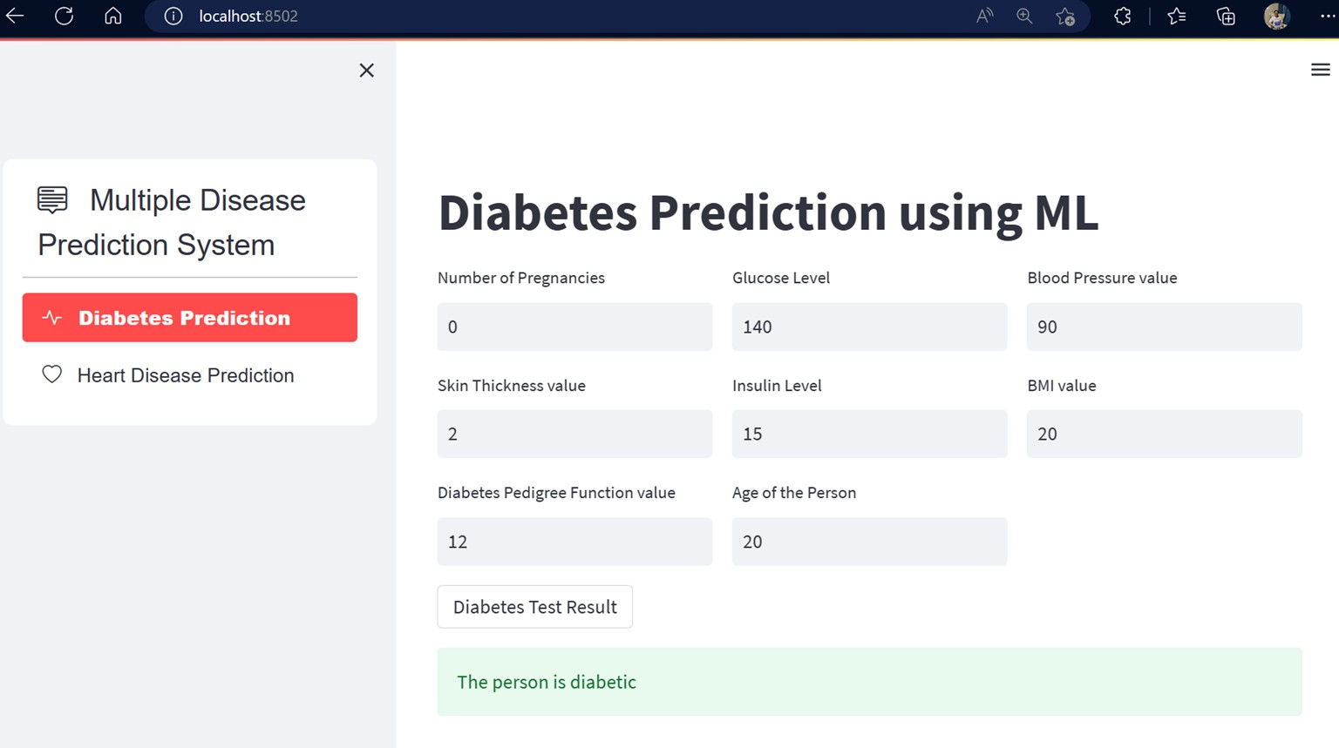
Result Snapshot
This is a page where the user can test based on the data he enter whether he has suffer from diabetes or not Based on the user input
Fig 21. The User Interface for Diabetes prediction

Slide 27
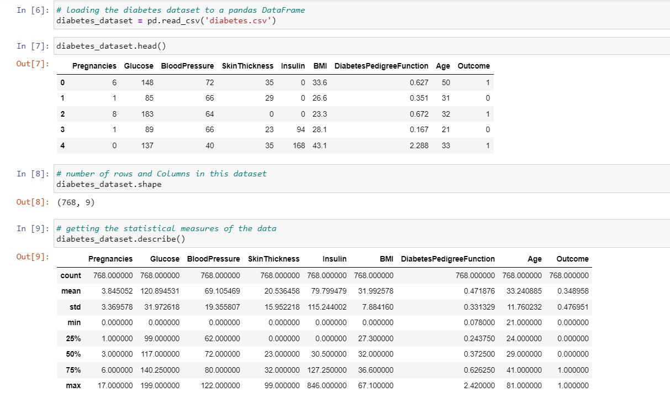
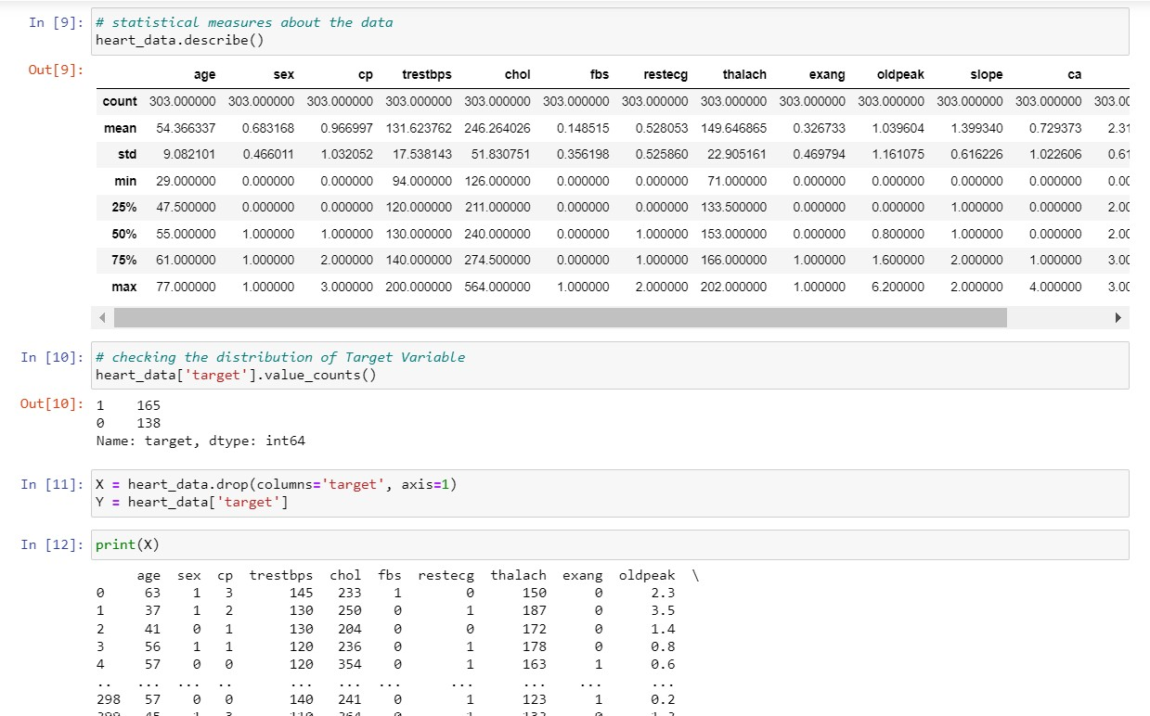
Fig 22&23. Training model for Diabetes and Heart

Slide 28
Reason For Specific Algorithm
For diabetes and heart disease prediction, we are using logistic regression model because it is a supervised learning technique and easy to use. In this technique, we feed the model with the data and the what will be the output for the certain set of input data.This gives us the output in the form of 0/1.This model is easy to use and easy to implement as it works on the prefeeded input data.Therefore, it has good accuracy.
For skin disease prediction, we are using CNN model. This uses the properties of feature extraction by creating patterns out of the images . Then, it divides the data/images on the basis of feature. Also, CNN model is best if we are working on the visual data such as images/videos. The accuracy of CNN model is good.

Slide 29

PROPOSED METHODOLOGY
Data Privacy and Security(Integrating Blockchain)
Continuous Monitoring and Feedback
Deployment and Scalability
Continuous Development and Updating
Increasing accuracy of our model

Slide 30
CONCLUSION
In conclusion, the development of MediMind, a comprehensive health prediction and record-keeping platform, has the potential to significantly improve healthcare outcomes by leveraging machine learning algorithms to predict and prevent diseases, while also providing a centralized platform for managing patient health records.
Through the use of advanced deep learning algorithms, such as neural networks and logistic regression models, MediMind can accurately predict and diagnose diseases, leading to earlier interventions and improved patient outcomes.

Slide 31
REFERENCES
Diagnosis of skin diseases in the era of deep learning and mobile technology Ahmed Elaziz, Moustafa M. Ghanem, Islam A. Tolba, Mohamed N. Mostafa, Mohammed A. https://www.sciencedirect.com/science/article/pii/S0010482521002523
A Method Of Skin Disease Detection Using Image Processing And Machine Learning Nawal Soliman ALKolifi ALEnezi
https://www.sciencedirect.com/science/article/pii/S1877050919321295
Diagnosis of skin diseases using Convolutional Neural Networks Jainesh Rathod, Vishal Aniru Sodha, Praseniit Bhavathankar https://ieeexplore.ieee.org/abstract/document/8474593
Deep Learning and Machine Learning Techniques of Diagnosis Dermoscopy Images for Early Detection of Skin Diseases Ebrahim
Mohammed Senan, Ibrahim Abunadi https://www.mdpi.com/2079-9292/10/24/315
Early Skin Disease Identification Using eep Neural Network Vinay Gautam, Naresh Kumar Trivedi, Abhineet Anand, Rajeev Tiwari, Atef Zaguia,Deepika Koundal 4 , Sachin Jain https://www.techscience.com/csse/v44n3/49136
Heart disease prediction using machine learning algorithms Harshit Jindal, Sarthak Agrawal, Rishabh Khera, Rachna Jain2and
Preeti Nagrath https://iopscience.iop.org/article/10.1088/1757-899X/1022/1/012072/met
Prediction of Heart Disease Using a Combination of Machine Learning and Deep Learning Rohit Bharti, Aditya Khamparia, Mohammad Shabaz, Gaurav Dhiman, Sagar Pande, and Parneet Singh https://www.hindawi.com/journals/cin/2021/8387680/

